Slide 1
Landing Trajectory Prediction for UAS Based on Generative Adversarial Network
Jun Xiang, Ph.D. Student
Drake Essick, Undergraduate student
Luiz Gonzalez Bautista, Undergraduate student
Junfei Xie, Associate Professor
Jun Chen, Assistant Professor
Department of Aerospace Engineering, Department of Electrical and Computer Engineering, SDSU
AIAA SciTech Forum 2023
Copyright © by Jun Xiang and Jun Chen. Published by the American Institute of Aeronautics and Astronautics, Inc., with permission.
Notes:
Hi，my name is Jun Xiang, and I am presenting the paper,
Landing trajectory prediction for UAS based on Generative Adversarial Network.
This work was done by Drake, Luiz, Dr. Xie, Dr. chen, and myself, from san diego state university.

Slide 2

Motivation
Predicting trajectory of Unmanned aerial vehicles (UAVs) become an important task for safety and economic reason.
Unmanned aerial vehicles (UAVs) are the future of aviation. FAA forecasts that there will be 1.81 million units of drone fleet by 2026.
in-network UAVs need to predict the trajectory of out-network UAVs
The security service needs to predict misused drones in public areas including airports, mass events, or public demonstrations
However, existing methods for UAV trajectory prediction are ordinarily very slow and unable to be applied online
In this paper, we focus on predicting the trajectory during the landing, because most accidents occur during the landing process
Notes:
According to FAA, there will be more than 1.81 million units of drone fleet by 2026, so we can say UAVs are the future of aviation.
Predicting trajectory of UAVs is very important because of safety and economic reason.
For example, if there is an unknown drone here, we would like to know its motion, so the security can catch it. Other drones also need its motion to avoid it.
Meanwhile, most UAV accidents occur during the landing process.
Therefore, in this paper, we will focus on the trajectory during the landing process.

Slide 3
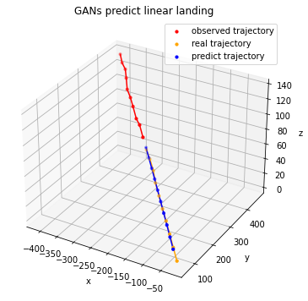




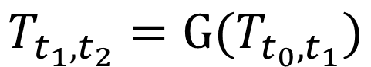



Problem Statement
$$T_{t_{0}, t_{1}}=[x_{t_{0}}, x_{t_{0}+1}, …,x_{t_{1}−1}, x_{t_{1}}]$$
$$T_{t_{1}, t_{2}}=[x_{t_{1}}, x_{t_{1}+1}, …,x_{t_{2}−1}, x_{t_{2}}]$$
We would like to predict $T_{t_{1}, t_{2}}$ if $T_{t_{0}, t_{1}}$is observed
$$T_{t_{1},t_{2}}=\text{G}(T_{t_{0}, t_{1}})$$
Notes:
So the problem is very simple.
Lets say there is a UAV, landing from, this point.
lets assume we have observed some of its motion. And we want to predict its future trajectory.
We would like to have a predictor, that can take trajectory of Time zero to time one as input, and generate the Trajectory from time 1 to time 2.

Slide 4
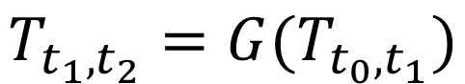
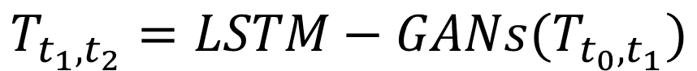
Method
$$T_{t_{1},t_{2}}=G(T_{t_{0}, t_{1}})$$
$$T_{t_{1},t_{2}}=LSTM−GANs(T_{t_{0}, t_{1}})$$
Notes:
in this paper, we proposed to use LSTM-GANs to predict the trajectory.

Slide 5
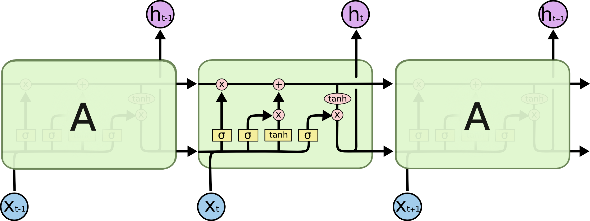
LSTM(Long short-term memory)
Proposed by Dr. Hochreiter in 1997
Is Recurrent Neural Networks which allow information to be passed from one step of the network to the next
Fig: LSTM structure
Image origin: https://colah.github.io/posts/2015-08-Understanding-LSTMs/
Notes:
LSTM which stand for long short-term memory, is one of the Recurrent Neural networks.
Which allow information to be passed from one step to the next step.
Sigmoid only output zero or 1, so its like a gate, identify if the information can pass the gate.

Slide 6
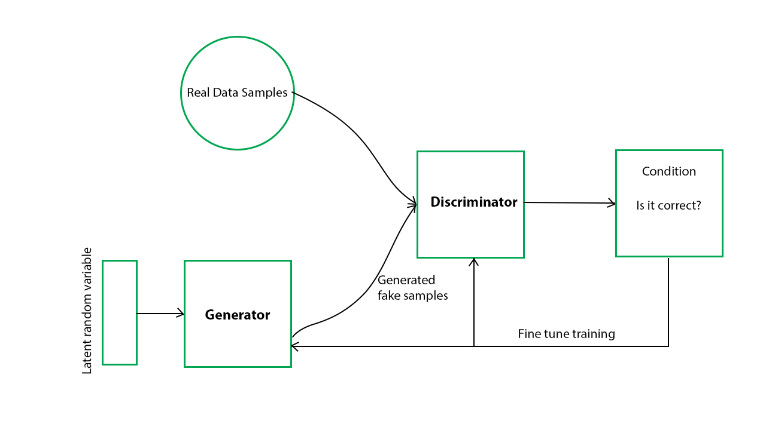
GANs(Generative adversarial networks)
Proposed by Ian Goodfellow in 2014
GANs structure
Image origin: https://www.geeksforgeeks.org/generative-adversarial-network-gan/
Notes:
GANs, which stand for Genrative adversarial network, consists of two neural networks, generator and discriminator,
And the generator and discriminator train against each other.

Slide 7
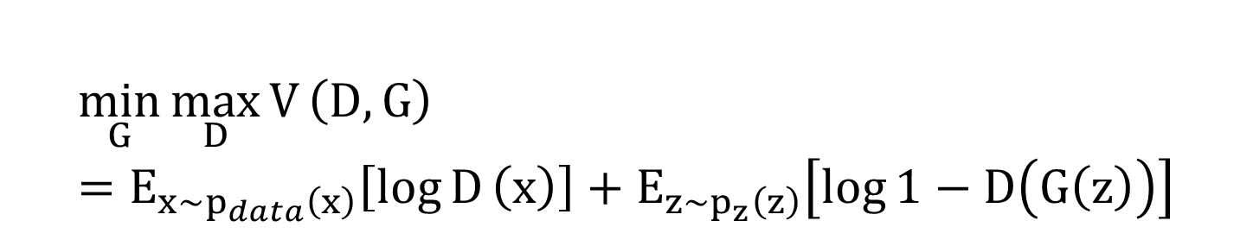
GANs(Generative adversarial networks)
$$\min_{G}{\max_{D}{V}}\left(D,G\right)=E_{x∼p_{data}\left(x\right)}\left[\log{D}\left(x\right)\right]+E_{z∼p_{z}\left(z\right)}\left[\log{1}−D\left(G\left(z\right)\right)\right]$$
z denoted the input factors.
G denotes the generator that takes z and generates trajectory G(z).
D denotes the discriminator and D(x) output the probability that x is a desired trajectory.
If G(z) is real, discriminator should give a high score, if G(z) is not similar to the real trajectory, discriminator should give a low score
Notes:
The training process is similar to a two-player min-max game with this objective function

Slide 8
LSTM-GANs Training
Generator
Notes:
In this paper, we use LSTM-GANs model to predict the trajectory.
LSTM-GANs is a very popular model recently.
Here is the training process. The generator has two LSTM modules, one pooling module and one MLP layer.
The generator will generate a fake trajectory.
The discriminator will compare the real trajectory and the fake trajectory and produce a loss.
The loss will be used to trained all the neural networks.

Slide 9
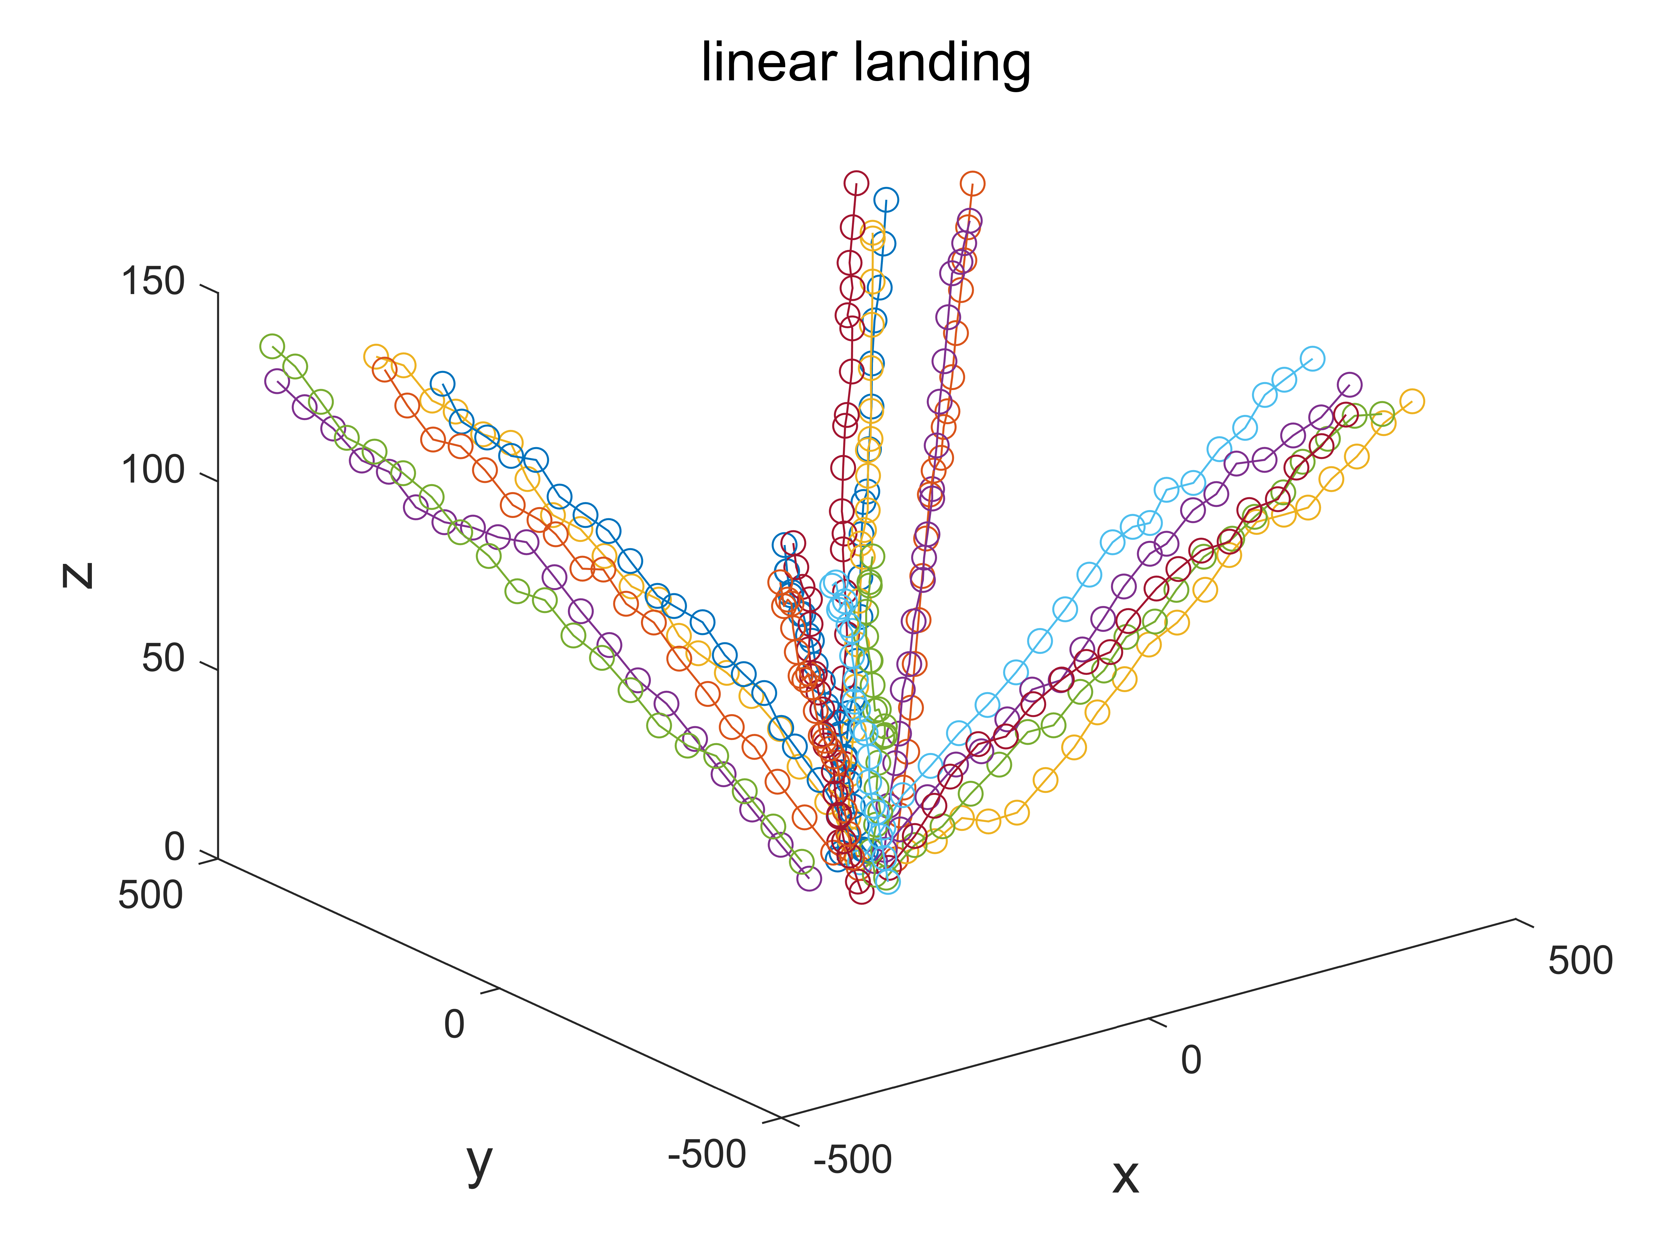
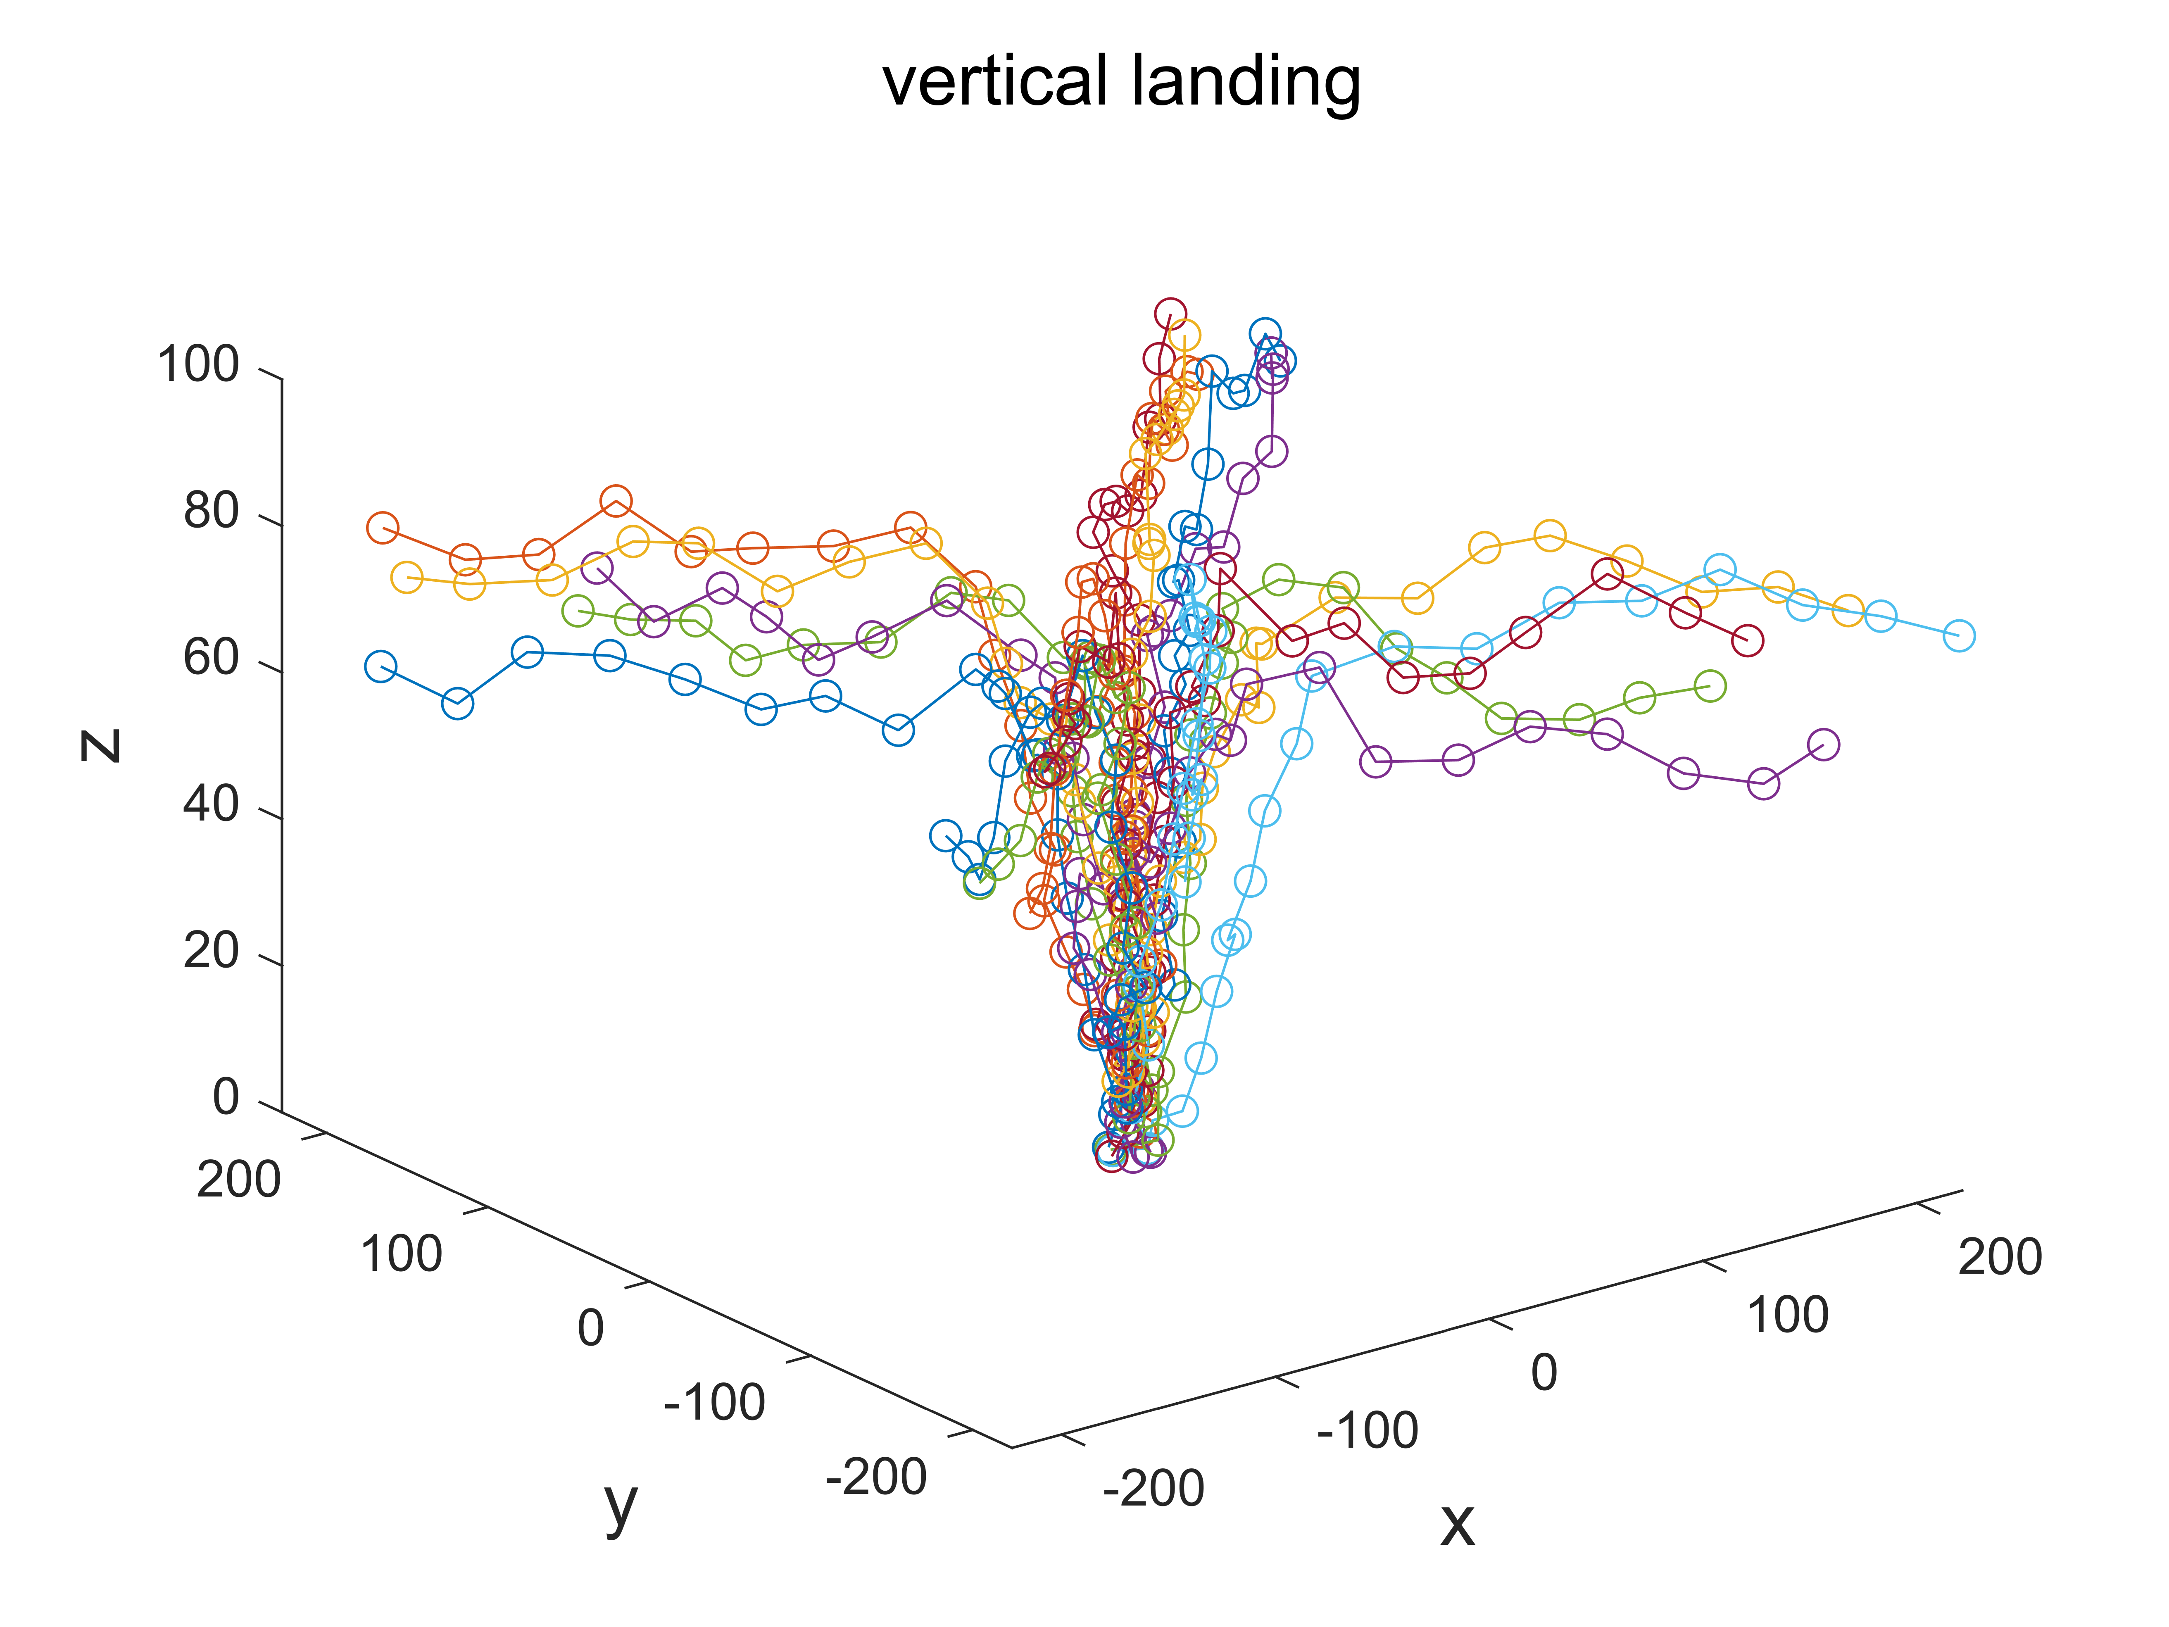
Datasets(simulated)
Notes:
In this paper, we will have three different trajectory dataset. Two of them are simulated. The first one is the linear landing dataset, the drone straightly land to the destination from four directions. The second one is the vertical landing, the vertical landing is similar , but it fly horizontally first, then start landing. These two datasets are inspired by the real drone landing motion.

Slide 10
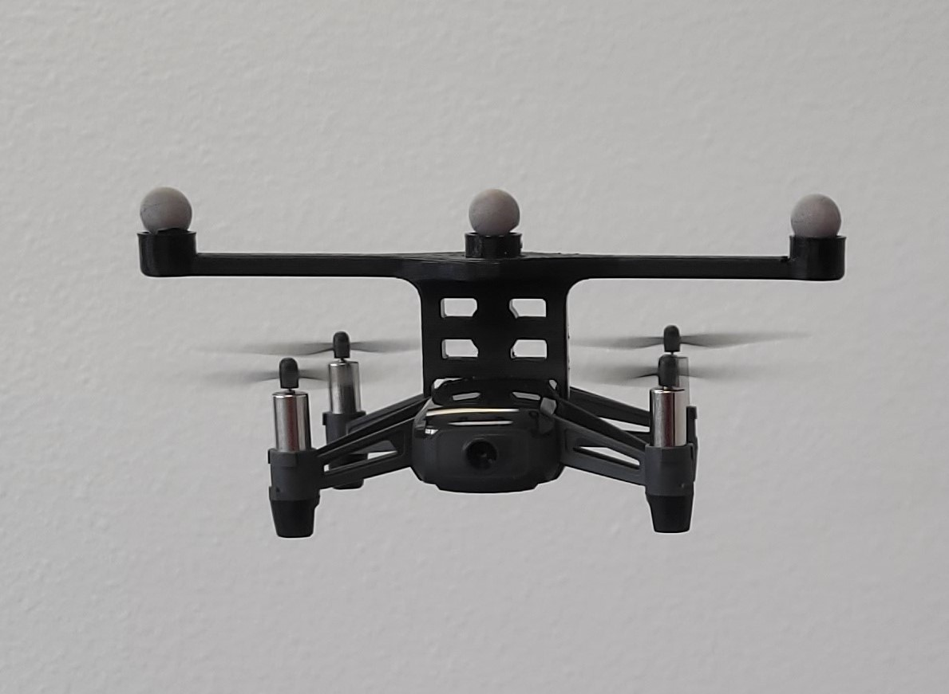
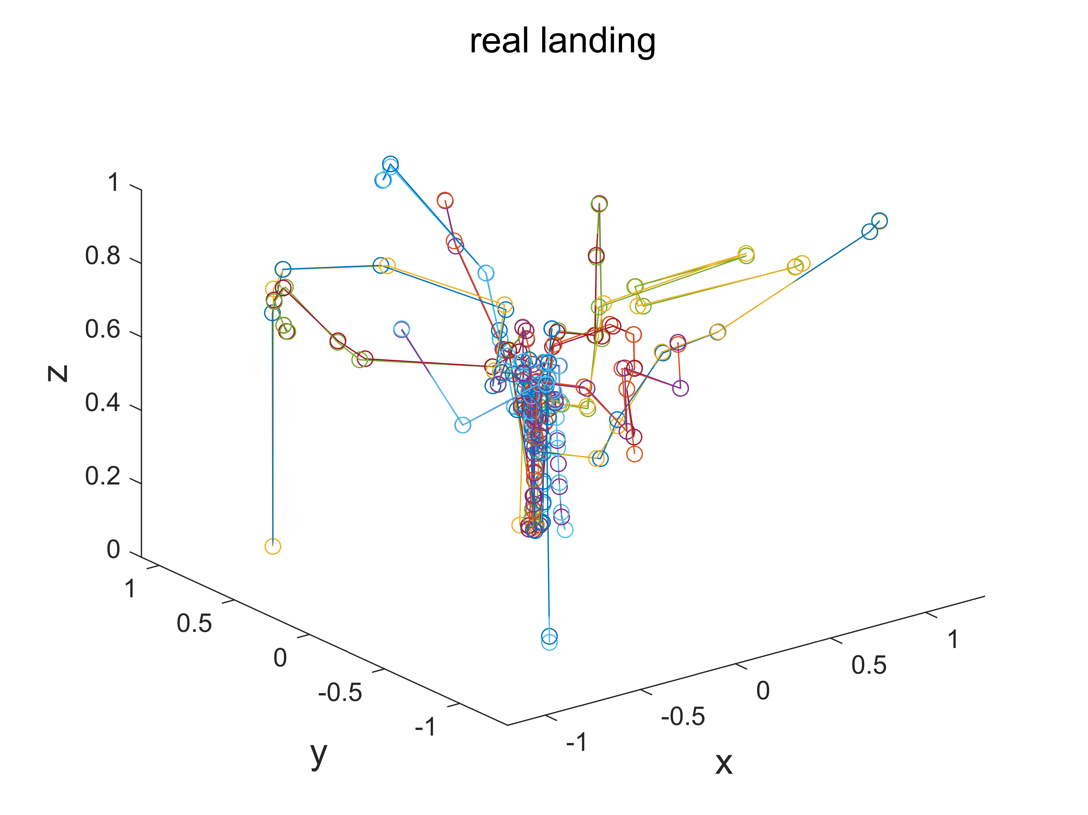
Datasets(real)
Fig: modified Dji Tello
Notes:
we also create a real trajectory dataset which created by real pilots. The pilots will control the drone to land from random start points. The trajectory only rely on the pilots.
The drone we used to collected data is a modified Dji Tello.
We added those balls to help us track the drone.

Slide 11
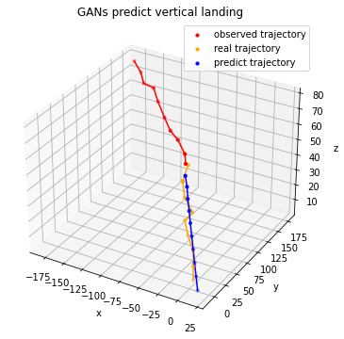
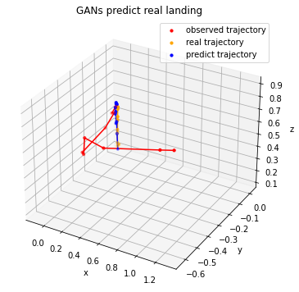
Results
Notes:
Here are some predicting example.
The red line is the past trajectory, the orange is the ground truth, and the blue line is the prediction generated by GANs.
All the trajectories in the dataset will be divided into past trajectory and future trajectory. Both past trajectory and future trajectory have 10 points.
We will observe the past trajectory and try to predict the future trajectory.

Slide 12
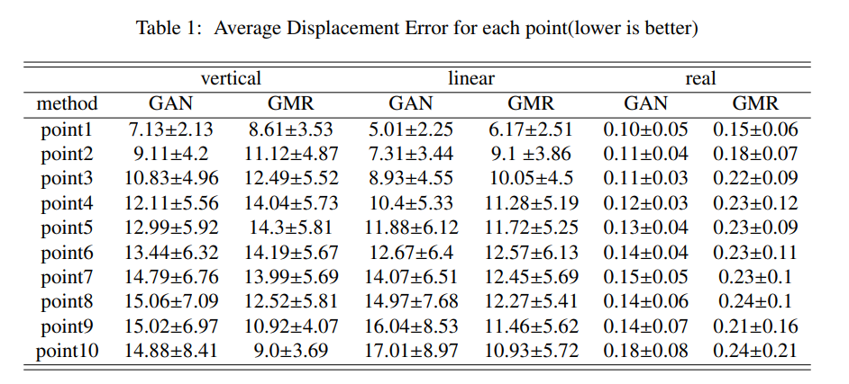
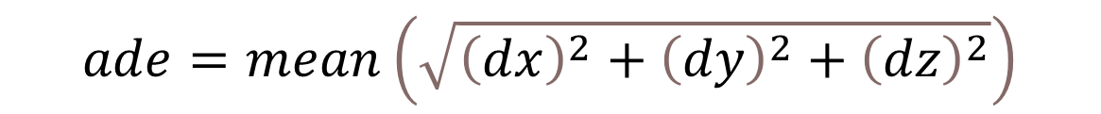
Results: Average Displacement Error performance
$$ade=mean\left(\sqrt{{\left(dx\right)}^{2}+{\left(dy\right)}^{2}+{\left(dz\right)}^{2}}\right)$$
Notes:
We use the Average Displacement Error to evaluate the prediction results. ADE is simply the mean straight distance between prediction trajectory and groundtruth.
As you can see, our method outperform the baseline,which is GMR predictor, in most cases especially for real dataset.

Slide 13
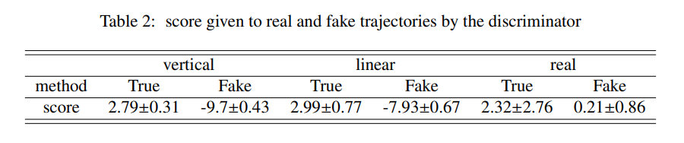
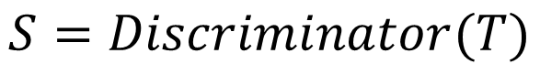
Results: Discriminator
$$S=Discriminator(T)$$
Notes:
We also test the trained discriminator. According to the result, the discriminator gives higher scores to the true trajectories. It proves that the discriminator can distinguish true and fake trajectories.

Slide 14
Conclusion and Future Implementation
Conclusion:
adopts a 2D trajectory GAN-based method to predict 3D landing trajectories of UAVs.
creates a real UAVs landing trajectory dataset for future research.
creates a discriminator can be used to evaluate predictions.
Future:
a new neural network encoder and decoder, which can process a larger amount of information is required for this GANs framework.
Notes:
This method may not work for long-term prediction. In the future, a new neural network encoder and decoder, which can process a larger amount of information is required for this GANs framework.

Slide 15
jxiang9143@sdsu.edu Jun.Chen@sdsu.edu

